Slide 1
A person-centred approach to Emotionally Based School Avoidance (EBSA): How to benefit autistic students, families, schools and communities
Matthew Wicks – Head of Outreach and Training

Slide 2
What we will cover today
What is EBSA?
Statistics
Pandemic impact
Assessment
Intervention
Case study

Slide 3
What is EBSA?
Emotionally Based School Avoidance
It has been called many things including school refusal, persistent absence, extended school non-attendance, anxiety related non-attendance
A learner is unable to go to school due to emotional or wellbeing factors
EBSA is the most used term currently, and for us it highlights the need without centring the blame on the individual
Notes:
Some debate over the best term to use, as we see in many areas

Slide 4
“School refusal occurs when stress exceeds support, when risks are greater than resilience and when ‘pull’ factors that promote school non-attendance overcome the ‘push’ factors that encourage attendance”
Thambirajah et al. (2008: p. 33)

Slide 5
Statistics
Absence rates for pupils in England
Notes:
Pre-pandemic to post pandemic increase across the board. Last year there was an increase for pupils with EHCP but not for those with no SEN support

Slide 6
Statistics
‘Pupil attendance in schools’ from the DfE
In the 2022-23 academic year, overall absence rate was 7.5% across all schools
22.5% of absent learners are recorded as persistently absent, almost double the pre-pandemic rate
13.3% for learners with an Education, Health and Care plan (EHCP), 11.1% for learners with SEND support and 6.9% with no identified SEND
The updated data we have now shows that while levels are stable for pupils with no SEN support (6.8% and 6.9%), for those with an EHCP it is still increasing (12.1% to 13.3%)
https://explore-education-statistics.service.gov.uk/find-statistics/pupil-attendance-in-schools/2023-week-29
Notes:
1.
2. Persistent absence = pupils who have missed more than 10% school sessions
3. Additional stat not on previous slide, 11.1% for SEND support
Is persistent absence the result of pupils not wanting to learn? - GL Assessment (gl-assessment.co.uk)

Slide 7
Some additional up to date statistics
Child of the North/Centre for Young Lives (2024)
306% increase in number of children waiting for an autism assessment since the pandemic
157,809 open referrals for suspected autism (September 2023)
More than 1 in 4 parents have had to wait over 3 years to receive support for their child
Only 26% autistic children feel happy at school
4 in 5 young autistic people have co-occurring mental health conditions
According to one study, 92.1% of children with school attendance difficulties were neurodivergent, and many were autistic
Notes:
No diagnosis can mean a lack of support
As above
As above
School isn’t a happy place to be, so children are staying away
Other factors that impact on ability to thrive in school – similar diagnostic waiting times
School distress and the school attendance crisis: a story dominated by neurodivergence and unmet need - PubMed (nih.gov)
N8 Research Partnership (2024). A country that works for all children and young people: An evidence-based plan for addressing the autism assessment and support crisis. doi.org/10.48785/100/195

Slide 8
General impact of EBSA
Kearney (2001)
Short term | Longer term
Academic problems Financial difficulties | Limited social and employment opportunities Occupational problems Adult mental health issues Heightened social difficulties

Slide 9
Solutions
What is already out there?
The majority of local authorities have guidance on EBSA
‘Assess – Plan – Do – Review’ model
Not aways easy to identify EBSA
Hard to support a learner in the home
Notes:
Guidance but not always practical solution
Standard practice in SEND
Can appear to be just illness/lateness etc – come back to this later
Realities of school resources mean its not possible to support in the home

Slide 10
Notes:
Next slide addresses these images

Slide 11
Solutions
What is already out there?
Recent government campaign to increase attendance
Noticeable omission of those learners experiencing EBSA
Focus on ‘pushing through’ and centring the issue with the learner
Punishment-based strategies: fines for parents – recently announced that fines will increase
From August 2024, the fine for school absences across the country will be £80 if paid within 21 days, or £160 if paid within 28 days
Notes:
100% attendance is unrealistic

Slide 12
What not to do!
Things we have heard in our assessments/interventions
“This won’t last forever” – said to learner doing colouring out of class
Staff were told not to talk to a learner if she was out of the classroom, so everyone ignored her
“This is not his autism, he is just being defiant” – said to a parent
“You are being manipulative” – said to a learner who couldn’t enter the school gates
“She has no empathy, she doesn't care if her mother misses work” – said in a meeting about the learner
Notes:
Not helpful things to hear for the learner/family

Slide 13
What can we do?
BeyondAutism’s approach
Information sharing
Whole school training – key people
Identifying signs
Assessment
Activating networks
Building rapport
Person-centred planning
Values/motivation
FBA
Intervention
Practical steps
Home/school input
SMART targets
These steps involve partnership working with schools/local authorities – providing our expert insight for those with complex support needs, while upskilling staff that we work with e.g. attendance lead at a school.

Slide 14
Signs of EBSA
What are some of the early signs?
Learner not wanting to go to school
Not wanting to get out of bed
Taking longer with the morning routine
Frequent negative talk about school
Saying their tummy aches
Increasing frequency of absences
Persistent lateness
Signs of burn out, e.g., going to sleep when they get home from school

Slide 15
Steps to supporting a learner experiencing EBSA
There are multiple ways to support a learner experiencing EBSA
There is no ‘one size fits all’ approach which works
EBSA is experienced in different ways by learners and it is not always easy to see until it’s too late
Early interventions with EBSA is very important, to prevent the downward spiral
All support put in place should be person-centred for it to be successful
Notes:
Downward spiral = missing some school leads to missing more and then it is harder to get back in and catch up academically/socially

Slide 16
Assessment
Activate the network
Gather as much information about the pupil including their history
Functional assessment interviews (FAI’s):
School
Parents
Other professionals involved
Questions you may ask
When did EBSA begin?
Is there a history of EBSA?
Any recent changes at home/school?
Current attendance
Interventions trialled
What behaviours are displayed
Notes:
Information gathering

Slide 17
Person-centred approaches
Where to start
A Person-Centred Plan (PCP) is not an assessment
It should respect the way that the individual communicates
Keeps the individual at the heart of any decisions
Identifies key people – this is vital for EBSA support
What’s important FOR
the individual
What’s important
TO
the individual
What’s important FOR
the individual
What’s important TO
the individual

Slide 18
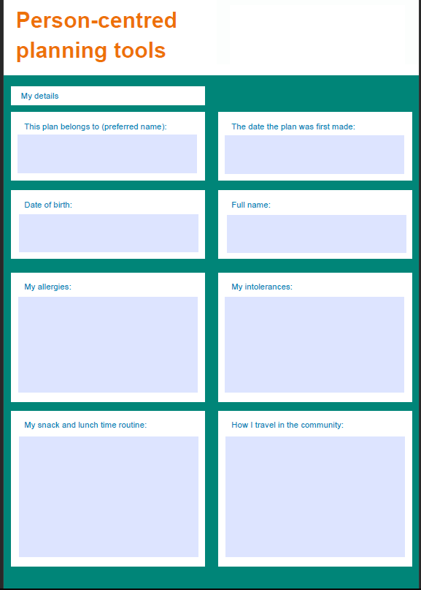
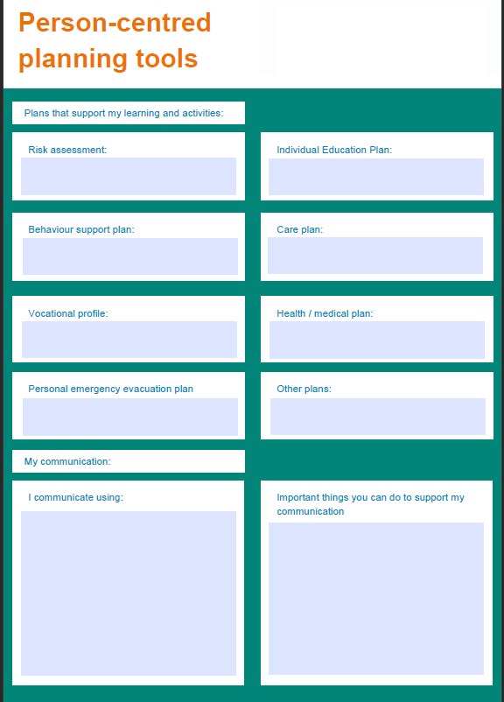
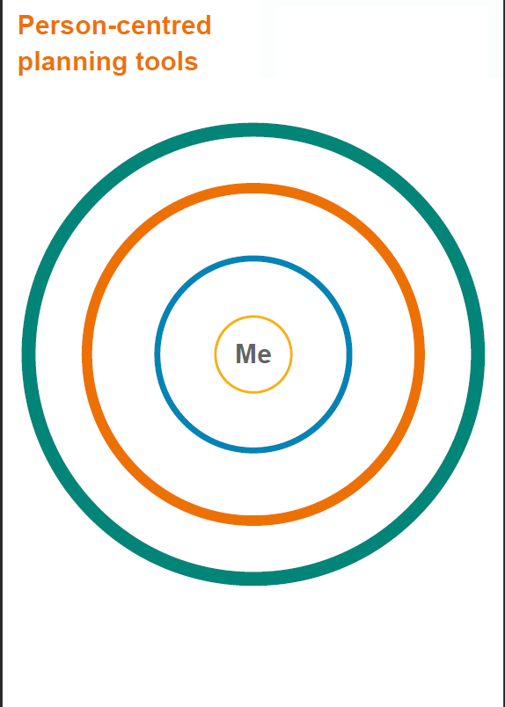

Slide 19
Assessment
Building rapport and positive associations
Very important process
Continue to build rapport throughout the intervention
Establish yourself as a safe person
Meet the pupil where they are
Home
School
Other safe space
Find out what the learner is interested in and get interested!
Notes:
Leads onto motivation/values in the next slide

Slide 20
Assessment
Understand their Values and Motivation
Get to know what motivates the learner
What are their values?
This information can be gathered through interviews, worksheets etc
Understanding the values and motivation will then guide the intervention
Notes:
Circle back to PCP slides – all the information in one place – important to/for

Slide 21
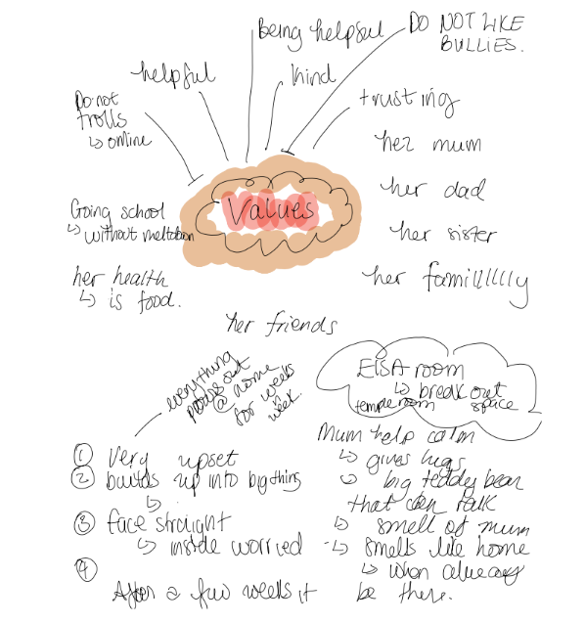
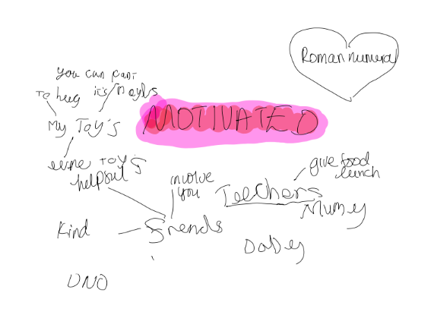

Slide 22
Assessment
Behaviour Analysis
Functional Behavioural Assessment (FBA)
Direct and indirect measures of behaviour
Kearney (2002b, 2006) School Refusal Assessment Scale-Revised
Functions of the behaviour
Notes:
FBA = all the work mention so far for assessment
As above
Specific school avoidance assessment – still uses the refusal language but it works well
Main goal is identifying function

Slide 23
Intervention
The assessment process is key in identifying the functions of a behaviour
Once complete, we move onto intervention
This means that the intervention meets the need of the individual
Bespoke
Person-centred
Function based

Slide 24
Intervention
Function based
Identifying the function leads to targeted interventions
Avoid school-related stimuli that provoke negative affectivity
Escape aversive and/or evaluative situations
Attention
Tangible rewards out of school
Notes:
Functions identified by Kearney SRAS-R

Slide 25
Intervention
Practical inputs
Reasonable adjustments
‘Quick wins’
Skill building (addressing the identified gaps)
Working in both school and home
Example - setting up a timetable for home and school

Slide 26
Intervention
1. Reasonable adjustments
Autism friendly environments
Part-time timetables
Adjustments to the curriculum
Notes:
Benefits all learners, not just neurodiverse ones
Shouldnt be long term solution but are often necessary to help individual to be successful and build up gradually
Reassessment of needs? Ed psych?

Slide 27
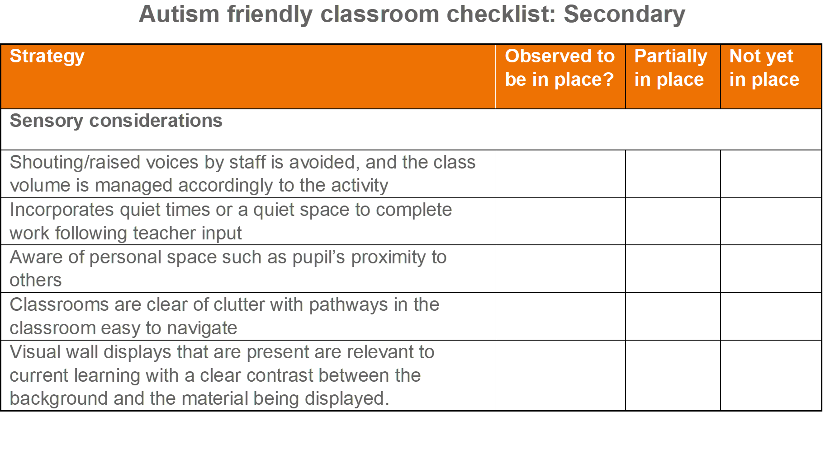

Slide 28
Intervention
2. ‘Quick wins’
Check ins
Check in’s with school and home - communication
Check in’s with the pupil first thing in the morning with a trusted adult
Reduce expectations
This can enable a ‘reset’
Not a long-term solution
Environment
Identify a safe space to take breaks in

Slide 29
Intervention
3. Skill building
Gaps that have been identified through the assessment process:
Difficulties with transitioning/navigating school
Bullying/no friendship group
Difficulty with curriculum
Identifying anxiety
Tailored support to address the identified gaps:
Additional adult support at the start and end of lessons
Alternative lunch time groups to work on socialisation
Adjustments made to the demands in class (pre-teaching, intervention groups etc)
Work on identifying trigger to anxiety

Slide 30
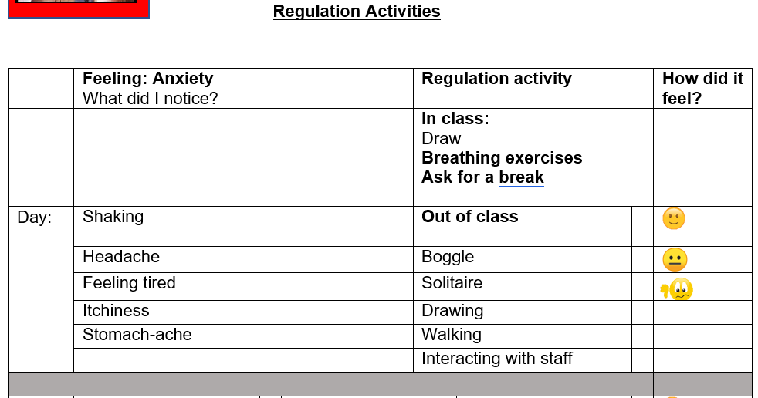
Notes:
Example worksheet for learner working on anxiety identification

Slide 31
Intervention
4. Working in school and home
Partnership working
Co-production with home and school
Also, with the wider interdisciplinary team
The most important thing that all interventions MUST include, no matter what, is collaboration with the learner themselves
Goal setting can be co-produced with the learner - what do they think would work?
These goals should be SMART

Slide 32
Case study
Teenage girl at an SEMH school
Assessment:​
FBA – primary function found to be escape/avoidance from sensory overload and social situations
Intervention:​
Values work through Acceptance and Commitment Therapy (ACT)
Break card – autonomy to use this when needed
Recognising triggers
Recognise body sensations
Dedicated space to use for breaks
Self-monitoring system
Identifying coping strategies when taking regulation break
Outcome:​
Increased access to school
Reduction in anxiety

Slide 33
Summary
What have we covered today?
We have looked at what EBSA is, and what it isn’t
Statistics show a real concern, and the rates are not returning to pre-pandemic levels
A thorough person-centred assessment will identify the functions of the behaviour which will in turn lead to function based interventions to support the return to school
Collaborative and flexible working between home and school is vital

Slide 34
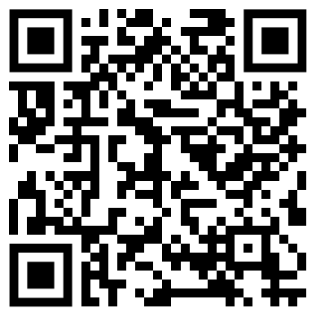
Matt Wicks: Head of Outreach and Training
mattwicks@beyondautism.org.uk
020 3031 9705 / 07552 151 277
Facebook: /beyondautism
Twitter: @beyondautismuk
LinkedIn: /company/beyondautism
Instagram: @beyondautism
Visit us in the exhibition space
Feedback

